Slide 1


<Mirra Afifah>
<23 Januari 2024>

Slide 2

Outline
Executive Summary
Introduction
Methodology
Results
Conclusion
Appendix

Slide 3
Executive Summary
Summary of methodologies
Data Collection (API and Web scraping)
Data Wrangling
EDA (Exploratory Data Analysist) with SQL and Visualization (Python)
Interactive Visual Analytics (Folium)
Machine Learning Prediction
Summary of all results
Result from EDA
Dashboard (Ploty & Dash)
Result from Predictive Analysist

Slide 4
Introduction
Project background and context
SpaceX advertises Falcon 9 rocket launches on its website with a cost of 62 million dollars; other providers cost upwards of 165 million dollars each, much of the savings is because SpaceX can reuse the first stage. Spaces X’s Falcon 9 launch like regular rockets. Stage two, or the second stage, helps bring the payload to orbit, but most of the work is done by the first stage. The first stage does most of the work and is much larger than the second stage.
The first stage is quite large and expensive. Unlike other rocket providers, SpaceX's Falcon 9 can recover the first stage. Sometimes the first stage does not land. Sometimes it will crash. Other times, Space X will sacrifice the first stage due to the mission parameters like payload, orbit, and customer.
In this context, if we can predict if the Falcon 9 first stage will land successfully, we can determine the cost of a launch. This information can be used if an alternate company wants to bid against SpaceX for a rocket launch.

Slide 5
Introduction
Problems you want to find answers
Determine the price of each launch.
Determine if SpaceX will reuse the first stage by training a machine learning model and use public information.
Determine the cost of a launch by predicting if the Falcon 9 first stage will land successfully

Slide 6

Section 1

Slide 7
Methodology
Executive Summary
Data collection methodology:
Data was collected through SpaceX API and Wikipedia Web scraping
Perform data wrangling
The categorical features was processed by One-hot-encoding
Perform exploratory data analysis (EDA) using visualization and SQL
Perform interactive visual analytics using Folium and Plotly Dash
Perform predictive analysis using classification models
Some models were trained, the parameters were tuned, and the last, we evaluated the optimum classification model.

Slide 8
Data Collection
Data was collected through 2 methods, that is SpaceX API and Wikipedia Web scraping
SpaceX API
Get request to SpaceX API
Use function call to response content as JSON
Web Scraping
Conduct web scraping from Wikipedia for Falcon 9 launch report using BeautifulSoup Library
Launch record extracted to HTML
json_normalize to turn data into dataframe
Cleaning data & handling missing values
Parse the table
Convert into dataframe

Slide 9
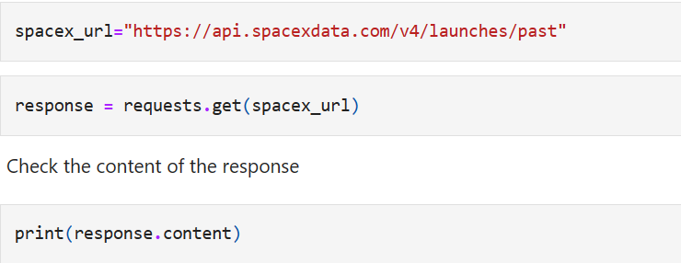
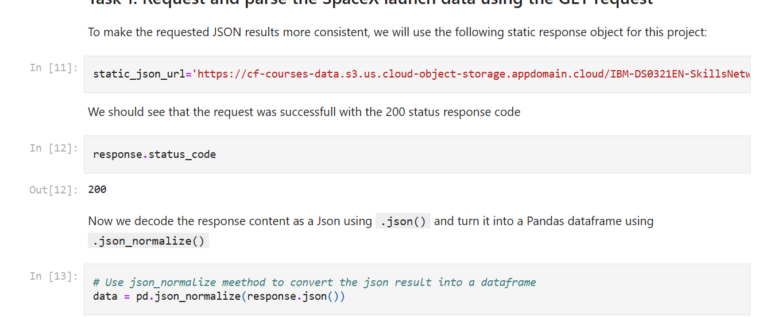
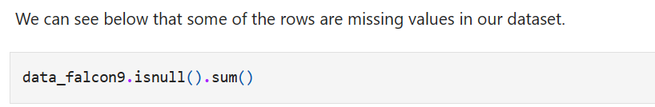
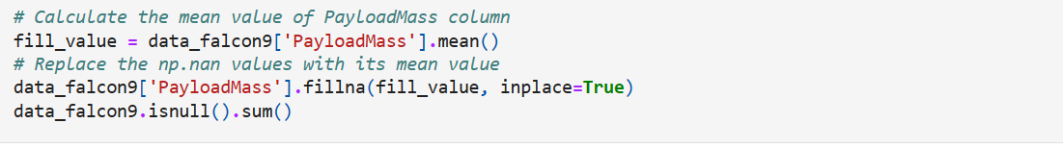
Data Collection – SpaceX API
Get request to SpaceX API
Use function call to response content as JSON
json_normalize to turn data into dataframe
Cleaning data & handling missing values
GitHub URL : https://github.com/mirraafifah/SpaceX-Falcon9/blob/5995973292ded3e06acda61dff23068b2ea17721/spacex-data-collection-api.ipynb

Slide 10
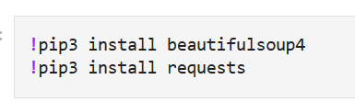
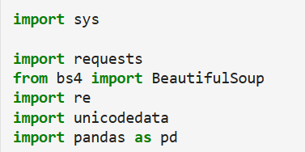
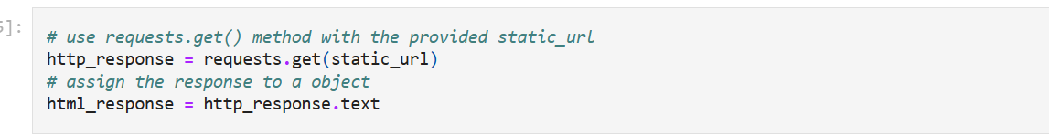
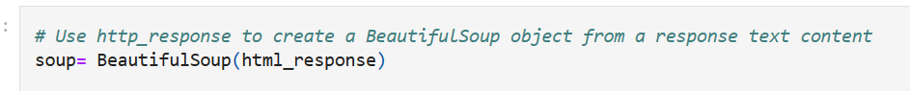
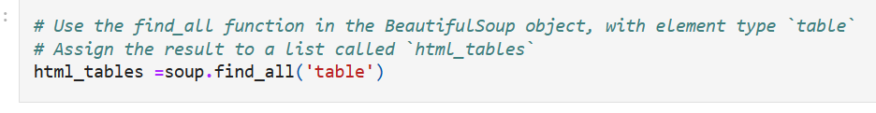
Data Collection - Scraping
Conduct web scraping from Wikipedia for Falcon 9 launch report using BeautifulSoup Library
Launch record extracted to HTML
Parse the table
Convert into dataframe
Github URL:
https://github.com/mirraafifah/SpaceX-Falcon9/blob/60c55eeacb2d1ac5f81af5adbdec956c1623d6a4/Data%20Collection-%20WebScraping.ipynb

Slide 11
Data Wrangling (1)
Exploratory Data Analysis (EDA) was conducted to find some patterns in the data and determine what would be the label for training supervised models.
On data wrangling process, the mission outcomes was converted into training labels with 1 means successfully landed and 0 means it was unsuccessful
Github URL:
https://github.com/mirraafifah/SpaceX-Falcon9/blob/397298abac45f5e96610726646afed587af44764/Data%20wrangling.ipynb

Slide 12
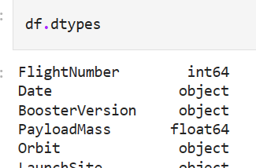
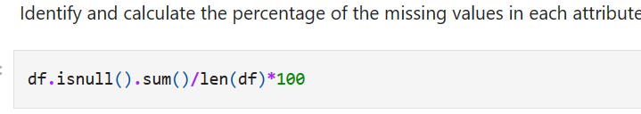
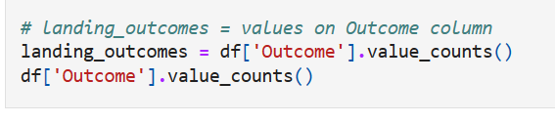
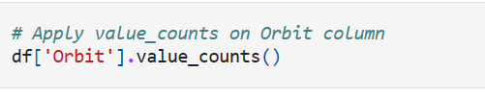
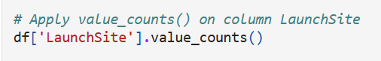
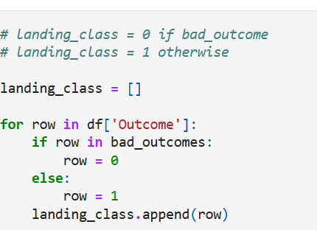
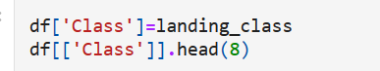
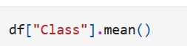
Data Wrangling (2)
Identify percentage of the missing values in each attribute. Identify which columns are numerical and categorical:
Use value_counts() method to determine the number of launches , orbit, landing outcomes on each site
Create a landing outcome label from Outcome column
This variable will represent the classification from outcome of each first launch. If the value is zero ==not land successfully; one == landed successfully

Slide 13
EDA with Data Visualization
Summary of plots/graphs
Catplot | Flight Number vs Payload Mass Flight Number and Launch Site Relationship Payload and Launch Site Relationship Flight Number and Orbit type Relationship Payload and Orbit type
It showed the relationship between one numerical variables and one or more than one categorical variables.
Barplot | The relationship between success rate of each orbit type
We can see the relationship from success rate (numerical) and orbit type (categorical).
Line Chart | The launch success yearly trend
The line chart can showed the time series, so it can display us the yearly trend.
Github URL: https://github.com/mirraafifah/SpaceX-Falcon9/blob/f907ad40dc9360a29b4d5f74dc8ba47f5a2bca29/EDA%20with%20Visualization.ipynb

Slide 14
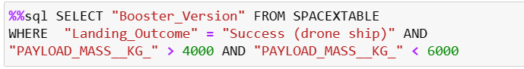
EDA with SQL (1)
Display the names of the unique launch sites in the space mission
Display 5 records where launch sites begin with the string 'CCA’
Display the total payload mass carried by boosters launched by NASA (CRS)
Display average payload mass carried by booster version F9 v1.1
List the date when the first successful landing outcome in ground pad was acheived.
List the names of the boosters which have success in drone ship and have payload mass greater than 4000 but less than 6000

Slide 15
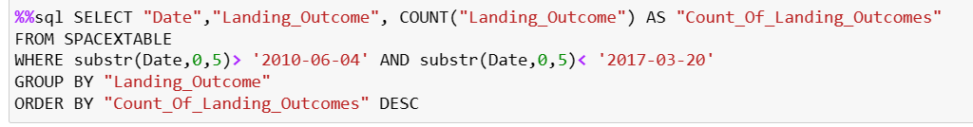
EDA with SQL (2)
List the total number of successful and failure mission outcomes
List the names of the booster_versions which have carried the maximum payload mass
Records of the month names, failure landing_outcomes in drone ship ,booster versions, launch_site for the months in year 2015
Rank the count of landing outcomes (such as Failure (drone ship) or Success (ground pad)) between the date 2010-06-04 and 2017-03-20, in descending order.
Github URL: https://github.com/mirraafifah/SpaceX-Falcon9/blob/9d7682704e9fc557cc35d82a555d857488bfd59a/EDA%20using%20SQLlite.ipynb

Slide 16
Build an Interactive Map with Folium
Summary of map objects
Map Objects
Marker | By adding marker, we can more intuitively observe and analyze the launch site position, such as analyze all launch sites in proximity to the Equator line or observing that all launch sites in very close proximity to the coast or not. We can also mark each success and failure from each launch site position.
Circles | By adding the circles, we can easily identify which launch sites have relatively high success rates.
Lines | By adding the lines, we can easily explore the launch sites proximity to see if we can easily find any railway, highway, coastline, etc.
GitHub URL:
https://github.com/mirraafifah/SpaceX-Falcon9/blob/0dfd7dd2e0520543af18f8df9794f9d5d619f3f4/Visualization%20with%20Folium.ipynb

Slide 17
Build a Dashboard with Plotly Dash
Summary of plots/graphs and interactions in dashboard
GitHub URL: https://github.com/mirraafifah/SpaceX-Falcon9/blob/b42922c4c975750c6159252372b520f2262f66a5/spacex_dash_app.py
Interactions
Launch Site Drop-down (Input Component) Range Slider to Select Payload | If ALL sites are selected, the display will return a pie chart graph that show the total success If a specific launch site is selected, , the display will return a pie chart graph that show only data for the selected site. The range slider make us easily select different payload range and see if we can identify some visual patterns.
Plot/Graph
Pie Chart Scatter Plot | pie chart visualizing launch success counts and the composition between successful launch vs unsuccessful launch. Scatter plot can make us visually observe how payload may be correlated with mission outcomes for selected site

Slide 18
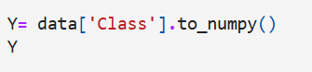
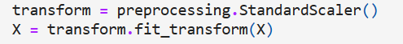
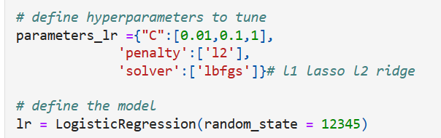
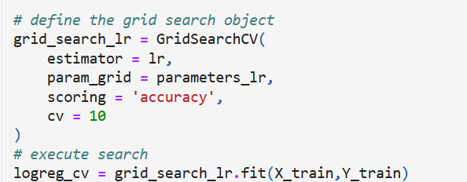
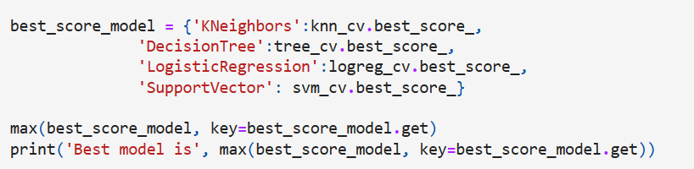
Predictive Analysis (Classification)
Summary of model development process
GitHub URL: https://github.com/mirraafifah/SpaceX-Falcon9/blob/6a4d6c47e8ddaa1efaee915251a5fe457540c497/Machine%20Learning%20Prediction.ipynb
Create a column for the class, Standardize the data, and split the data into training and testing data using the function
The training data is divided into validation data, a second set used for training data; then the models are trained and hyperparameters are selected using the function (GridSearch)
Find best Hyperparameter for SVM, Classification Trees and Logistic Regression
Find the method performs best using test data

Slide 19
Results
Exploratory data analysis results
Interactive analytics demo in screenshots
Predictive analysis results

Slide 20

Section 2

Slide 21
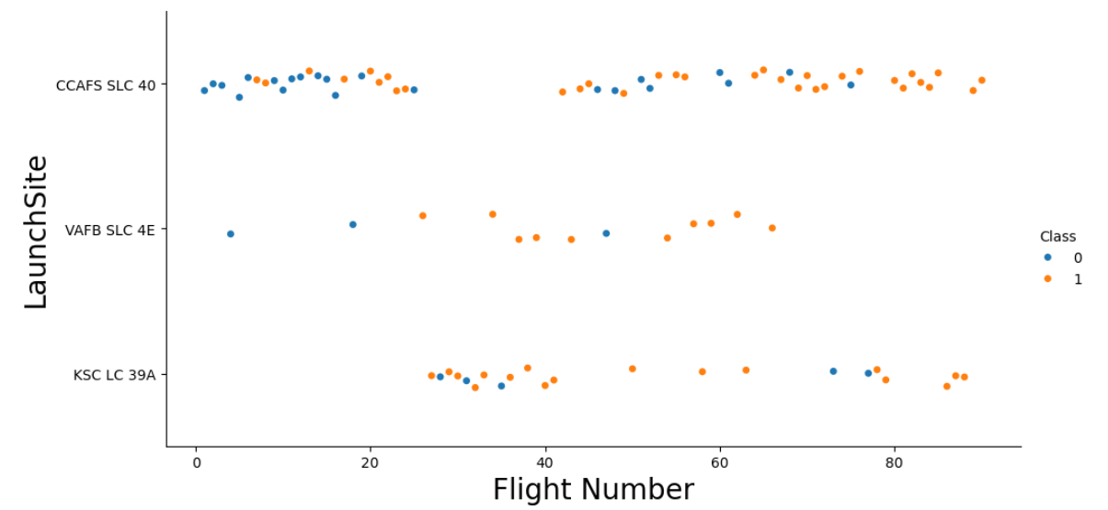
KSC LC-39A and VAFB SLC 4E
KSC LC-39A and VAFB SLC 4E
Flight Number vs. Launch Site
Scatter plot of Flight Number vs. Launch Site
For launch site CCAFS LC-40 and VAFB SLC 4E the successful launch case, are highly appeared on higher flight number. However, it seems there is no relationship of Launch site and Flight Number for KSC LC-39A .

Slide 22
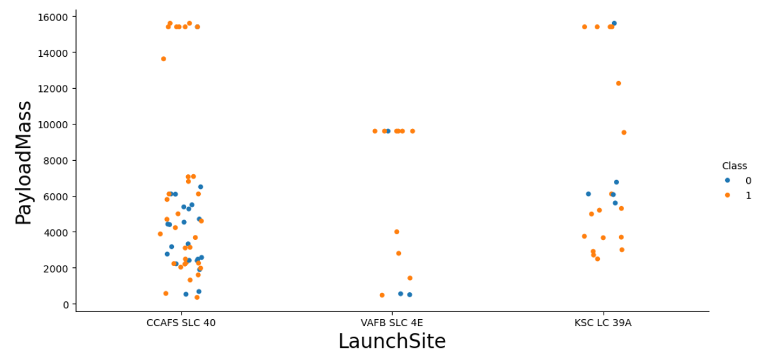
Payload vs. Launch Site
Scatter plot of Payload vs. Launch Site
For the VAFB-SLC launch site there are no rockets launched for heavy payload mass(greater than 10000). For CCAFS LC-40 there are no rockets launched for medium payload mass (between 8000 and 12000), and for KSC LC-39A there are no rockets launched for light payload mass (below 2000 ).
For CCAFS SLC-40, rockets launched for heavy payload mass (greater than 12000) give a high success rate.

Slide 23
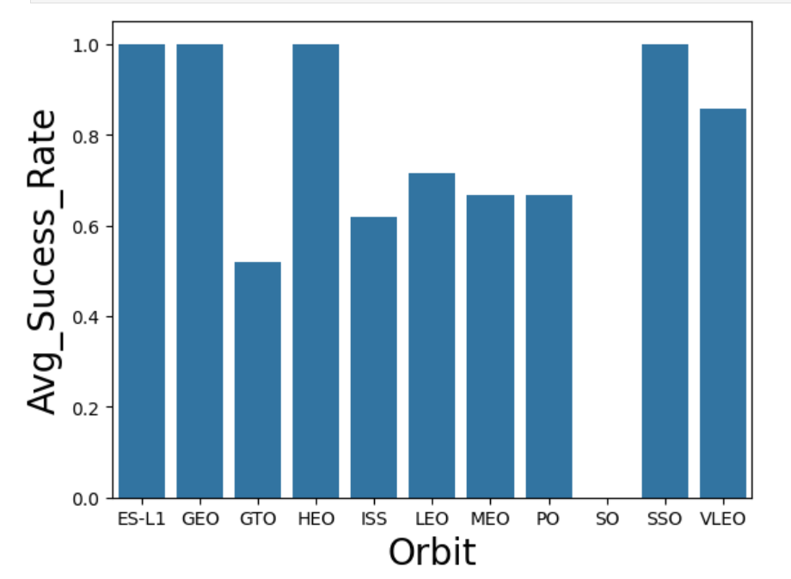
Success Rate vs. Orbit Type
Bar chart for the success rate of each orbit type
The most success rate orbits are ES-L1, GEO, HEO, SSO, and VLEO.

Slide 24
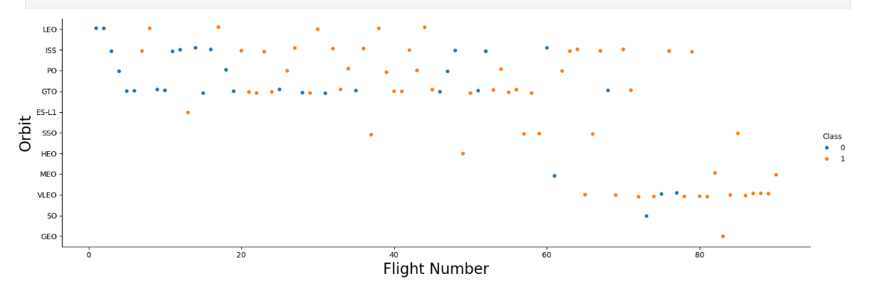
Flight Number vs. Orbit Type
Scatter point of Flight number vs. Orbit type
LEO orbit the Success appears related to the number of flights; on the other hand, there seems to be no relationship between flight number when in GTO orbit.

Slide 25
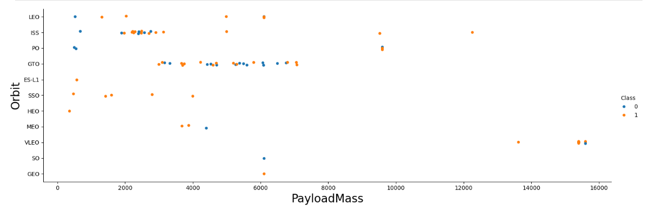
Payload vs. Orbit Type
Scatter point of payload vs. orbit type
With heavy payloads the successful landing or positive landing rate are more for Polar, LEO and ISS.
However for GTO we cannot distinguish this well as both positive landing rate and negative landing(unsuccessful mission) are both there here.

Slide 26
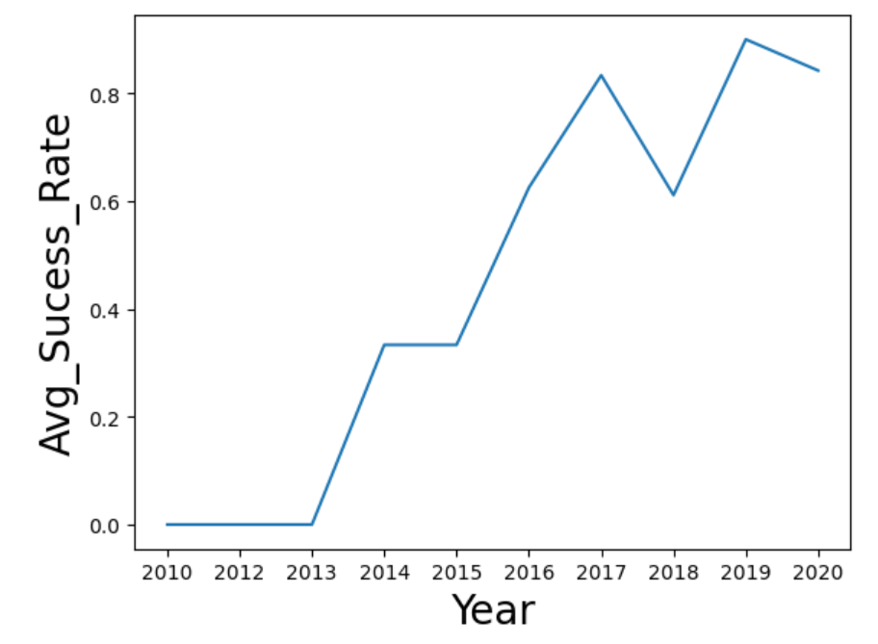
Launch Success Yearly Trend
Line chart of yearly average success rate
the success rate since 2013 kept increasing till 2020

Slide 27
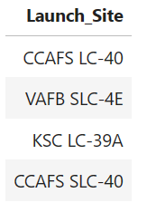
All Launch Site Names
Find the names of the unique launch sites
The launch site for Falcon-9 rockets launches is VAFB SLC – 40 For CCAFS LC-40, KSC LC-39A and, CCAFS SLC-40

Slide 28
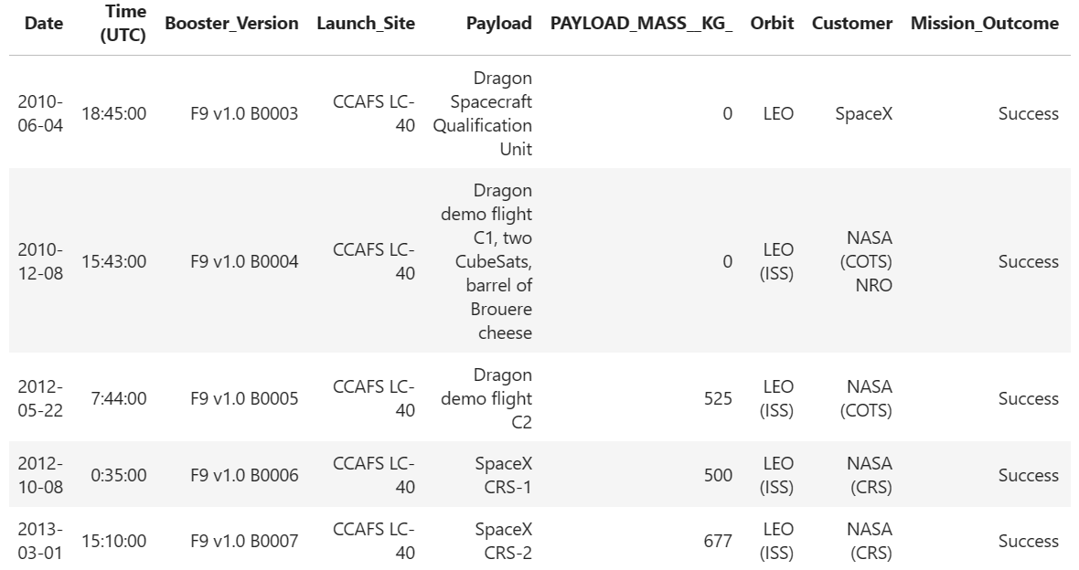
Launch Site Names Begin with 'CCA'
Find 5 records where launch sites begin with `CCA`
The all 5 records where launch sites begin with `CCA`(2010 – 2013) have success mission outcome

Slide 29
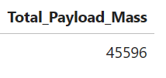
Total Payload Mass
Calculate the total payload carried by boosters from NASA
total payload mass carried by boosters launched by NASA (CRS) is 45596

Slide 30
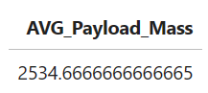
Average Payload Mass by F9 v1.1
The average payload mass carried by booster version F9 v1.1
average payload mass carried by booster version F9 v1.1 is 2534.67

Slide 31

First Successful Ground Landing Date
The dates of the first successful landing outcome on ground pad
The dates of the first successful landing outcome on ground pad is December 22th, 2015.

Slide 32
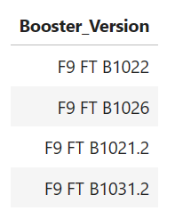
Successful Drone Ship Landing with Payload between 4000 and 6000
The names of boosters which have successfully landed on drone ship and had payload mass greater than 4000 but less than 6000

Slide 33
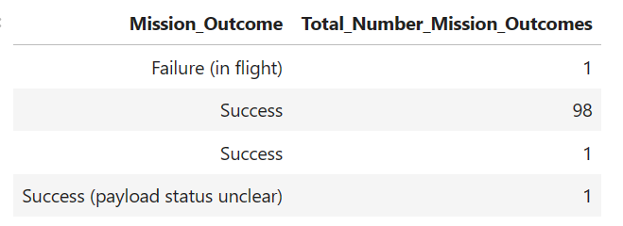
Total Number of Successful and Failure Mission Outcomes
The total number of successful and failure mission outcomes

Slide 34
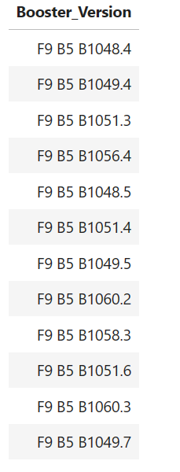
Boosters Carried Maximum Payload
The names of the booster which have carried the maximum payload mass

Slide 35
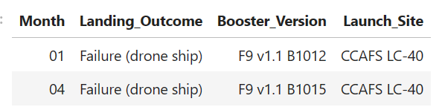
2015 Launch Records
The failed landing_outcomes in drone ship, their booster versions, and launch site names for in year 2015

Slide 36
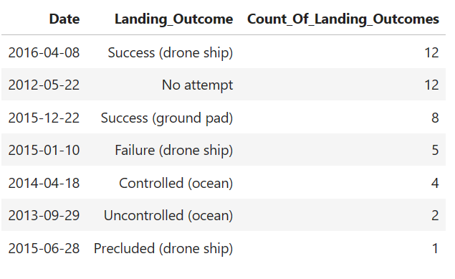
Rank Landing Outcomes Between 2010-06-04 and 2017-03-20
The count of landing outcomes (such as Failure (drone ship) or Success (ground pad)) Rank between the date 2010-06-04 and 2017-03-20, in descending order

Slide 37

Section 3

Slide 38
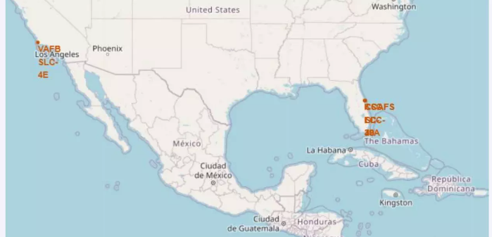
All Launch Sites’ Location Markers on a Global Map
As we can see, all the launch sites located near Florida, USA and California, USA

Slide 39
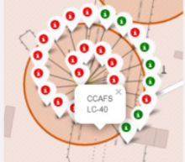
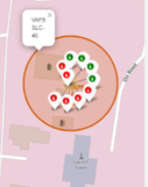
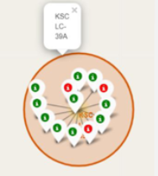
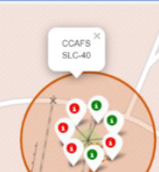
The Color-Labeled Launch Outcomes
We can see the successful landing from each launch sites
The green label means successful and the red label means failure

Slide 40
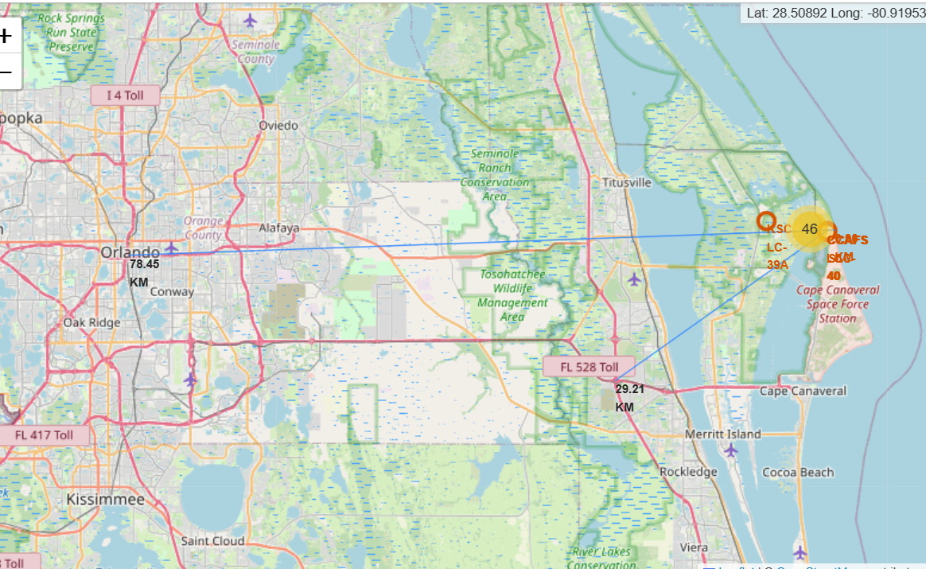
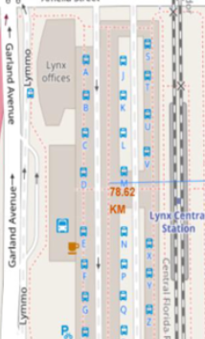
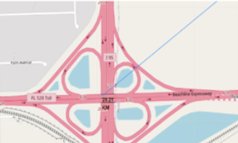
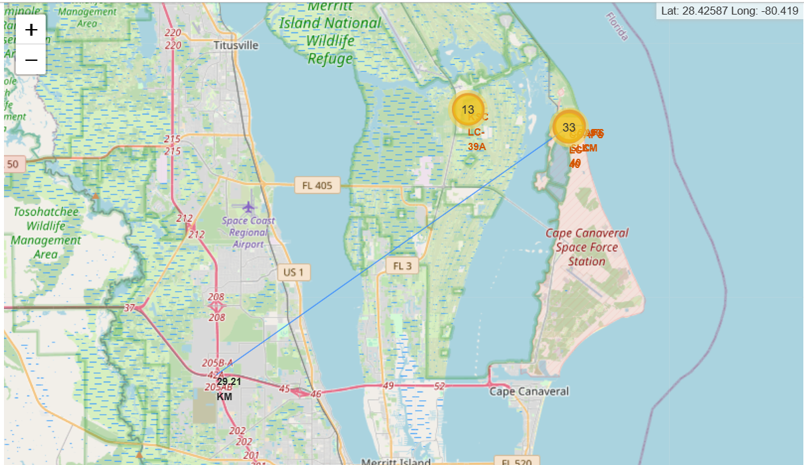
The Launch Site to Its Proximities
The launch sites are not in close proximity to railways and to highways
The launch sites are in close proximity to coastline
The launch sites keep certain distance away from cities?

Slide 41

Section 4

Slide 42
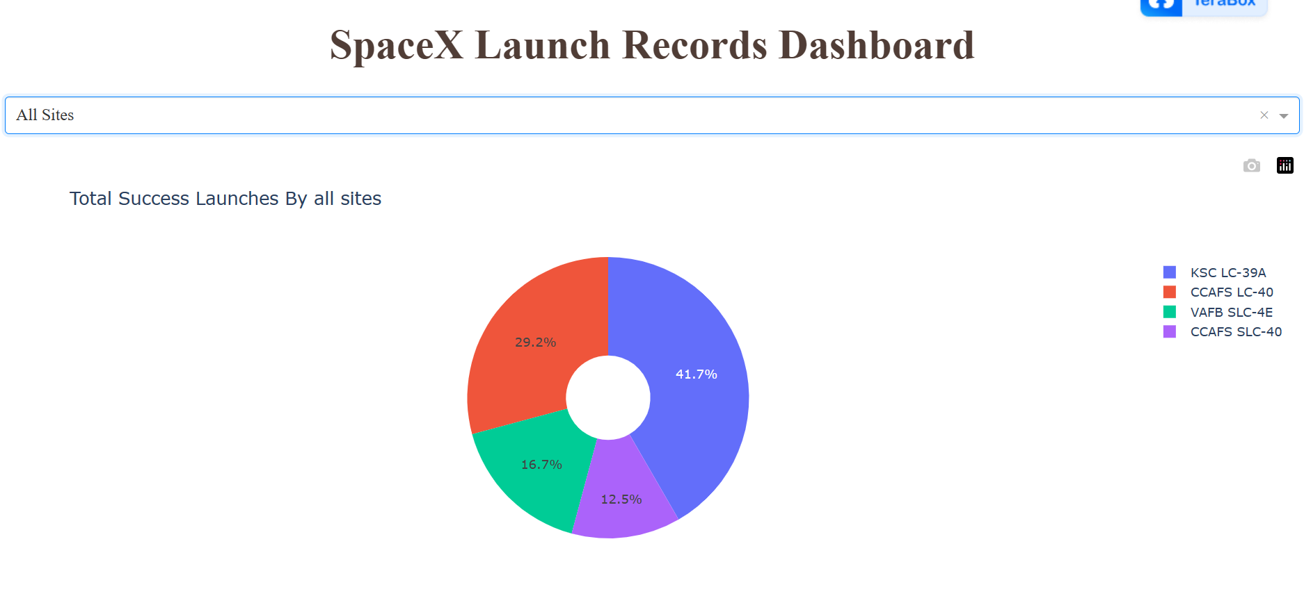
Pie Chart Displaying Success Percentage from Each Sites
Total success launches for all sites

Slide 43
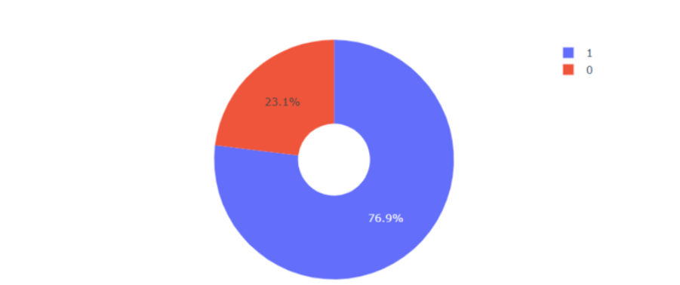
Pie chart for the Launch Site with Highest Launch Success Ratio >
Launch site with highest launch success ratio is KSC LC-39A. That launch site achieved 76.9% successful launches and 23,1% failure launches.

Slide 44

< Payload vs. Launch Outcome scatter plot for all sites >
payload range 2000 until 3800 kg and range 4500 until 5300 kg have the larger success rate than others payload mass
booster version F9 v1.1 B1010 has the largest success rate

Slide 45

Section 5

Slide 46

Classification Accuracy
The bar chart of model accuracy for all built classification models
The model that has the highest classification accuracy is Decision Tree Classification Model (accuracy 0.873), with the best parameters is {'criterion': 'gini', 'max_depth': 6, 'max_features': 'sqrt', 'min_samples_leaf': 2, 'min_samples_split': 5, 'splitter': 'random'}

Slide 47

Confusion Matrix
Examining the confusion matrix, we see that Decision Tree can distinguish between the different classes. However we can see that the major problem is false positives.

Slide 48
Conclusions
The flight amount of the launch site can give an effect to its success rate. The larger the flight amount, the greater success rate can be generated.
Starting from 2013 until 2020, the launch success rate keep increasing.
The most success rate orbits are ES-L1, GEO, HEO, SSO, and VLEO.
Launch site with highest launch success ratio is KSC LC-39A
For this SpaceX case, the best machine learning algorithm model is Decision Tree Classifier

Slide 49
Appendix
For complete data and understanding, please kindly check my Github:
mirraafifah/SpaceX-Falcon9: SpaceX Falcon 9 rocket launches - This project will determine if the first stage will land also determine the cost of a launch. (github.com)

Slide 50


